Slide 1
John Droescher’s Restaurant
Leslie Rosario
Shadman Samad

Slide 2
TABLE OF CONTENTS
01
02
03
Objective
The Dataset
Actionable Insights
Opening a restaurant in NYC
Restaurant & Violation Data
What the data recommends

Slide 3
Objective
Identify what factors, such as:violation code, geographic area, cuisine type, and inspection date, have an impact on the survivability and prevention of closure in restaurants.

Slide 4
Dataset
restaurant_data
27,483 Restaurants in NYC
violation_data
8,706 closures by NYC DOHMH
243,860 reported violations
2015 - 8/2022

Slide 5
Actionable
Insights
Parsing the data to create actionable insights for opening a surviving restaurant in NYC

Slide 6
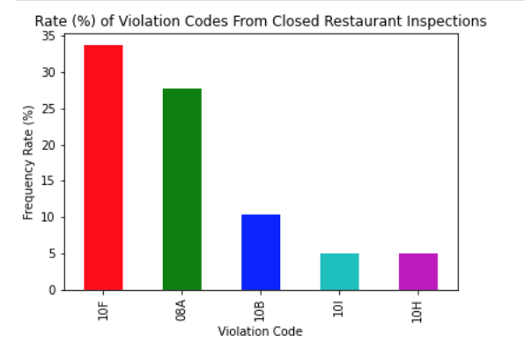
Violation Code Closure Rate
10F - “Non-food contact surface improperly constructed. Unacceptable material used.”
08A - “Facility not vermin proof.”
10B - “Plumbing not properly installed or maintained; Backflow prevention device not provided where required.”
10I - “Single service item reused, improperly stored, dispensed; not used when required.”
10H - “Proper sanitization not provided for utensil ware washing operation.Single service article not provided.”

Slide 7
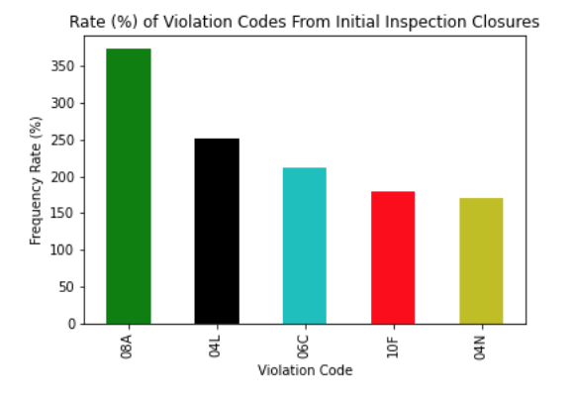
Violation Code Closure Rate
08A - “Facility not vermin proof.”
04L - “Evidence of mice or live mice in establishment's food or non-food areas.”
06C - “Food not protected from potential source of contamination during storage, preparation, transportation, display or service.”
10F - “Non-food contact surface improperly constructed. Unacceptable material used.”
04N - “Filth flies present in facility’s food and/or non-food areas. ”

Slide 8
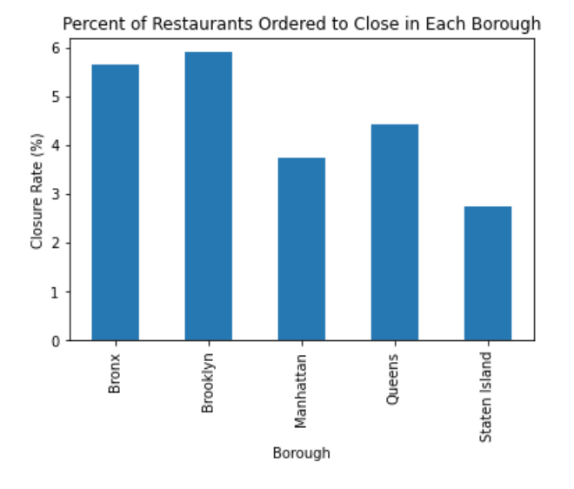
Location | Borough
5.63%
5.90%
4.41%
3.73%
2.75%

Slide 9
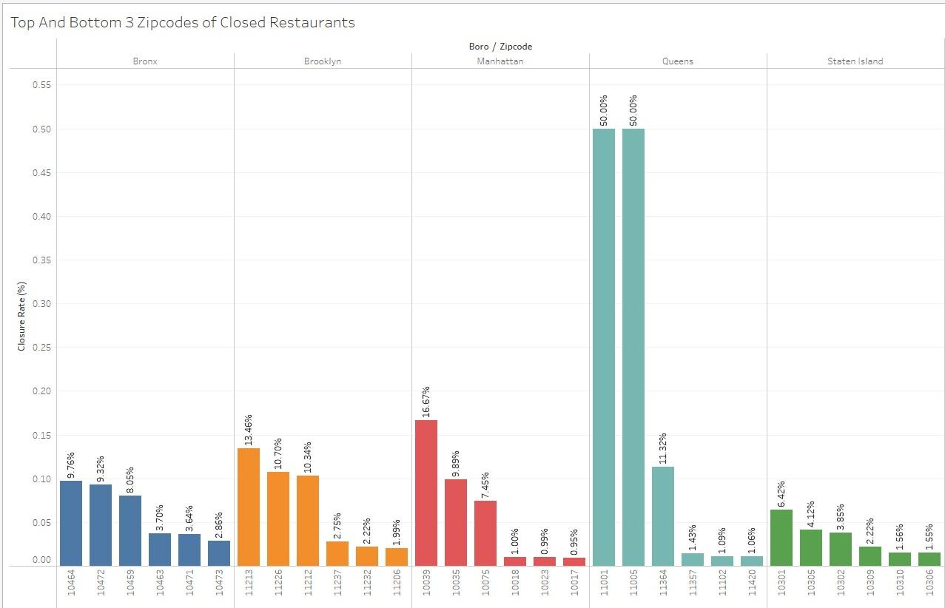
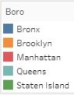
Location | Zip Code & Borough Closures

Slide 10
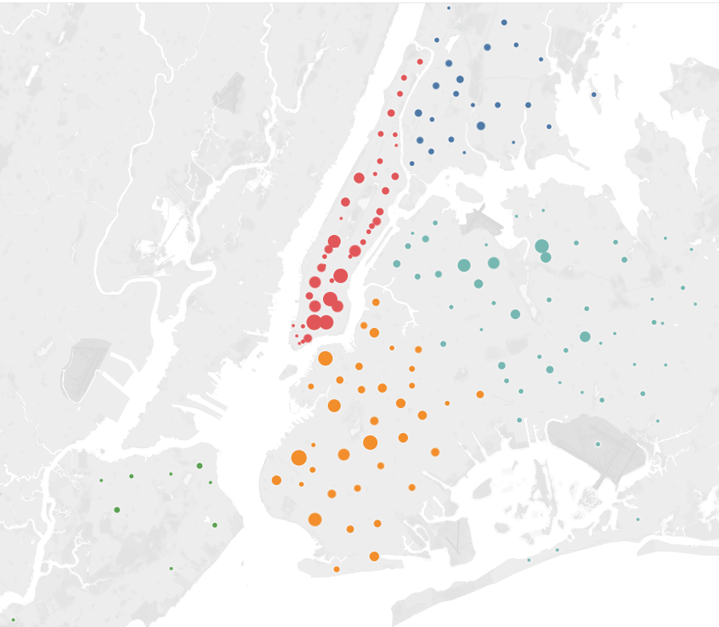
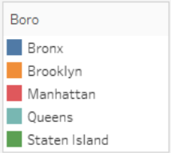
Location | Map of Restaurant Closures

Slide 11
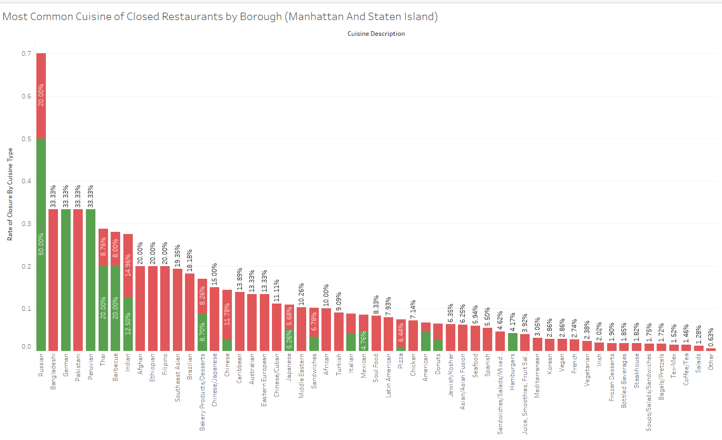

Cuisine Type | Man. | S.I.

Slide 12
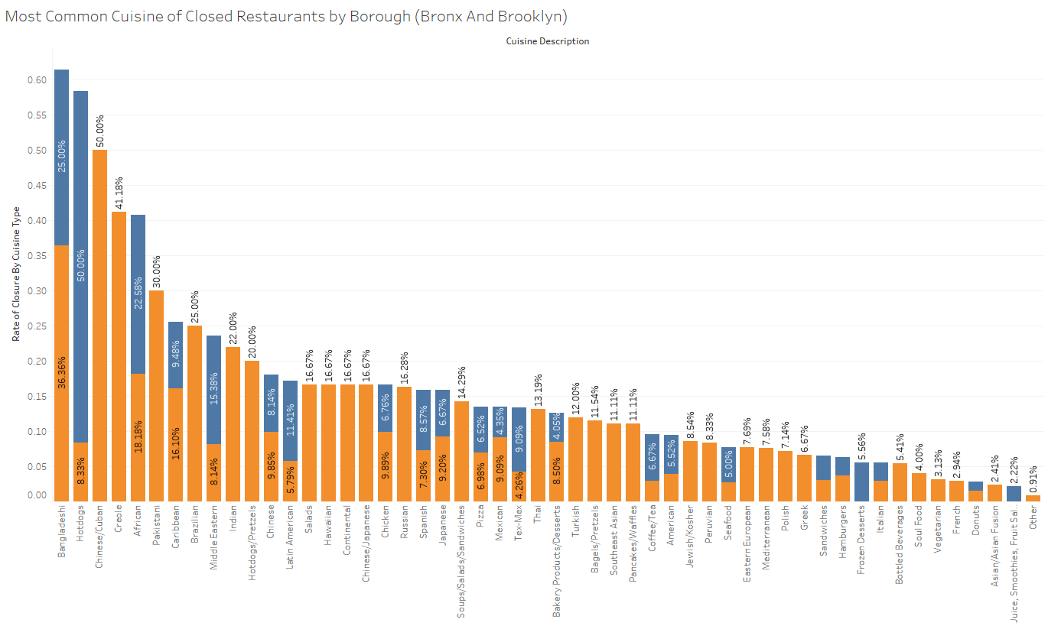

Cuisine Type | Bx | Bk

Slide 13
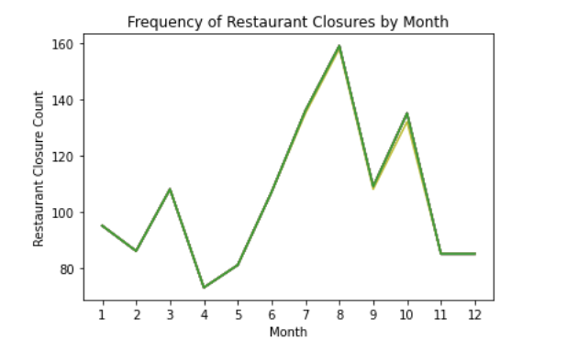
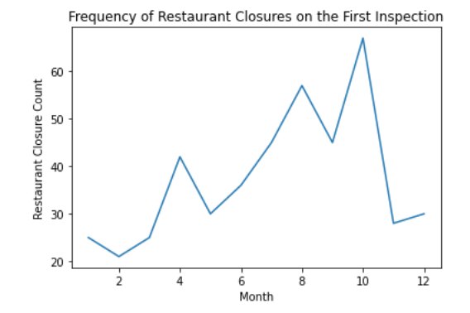
Opening Date?

Slide 14
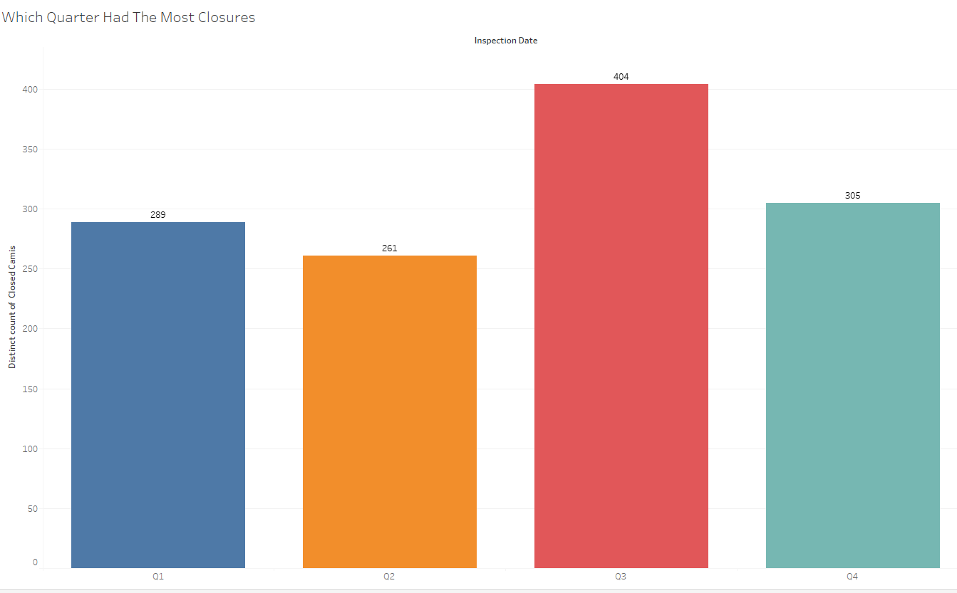
Opening Date?

Slide 15
OUR SOLUTIONS
Violations
Time of Year
Avoid there public health violations that are most likely to result in an immediate closure:
08A
04L
06C
10F
04N
The data shows that November is the best month to open a restaurant. Avoid opening in the summer and beginning of fall.
06C
10H
10I

Slide 16
OUR SOLUTIONS
Location
Cuisine Type
The best boroughs to open up a restaurant in NYC are Manhattan and Staten Island according to the data.
Cuisine types you should avoid basing your restaurant on are:
Manhattan | Staten Island
Bangladeshi Russian
Pakistani German
Peruvian

Slide 17
THANKS
Do you have any questions?

